Slide 1
A Rough Moving Points Filtering Method in Lidar SLAM
Group members:
Kevin Sinaga
Rigel Madraswalla
Samson Braun
Zuchen Zhang *All members have completed TRACE

Slide 2
Overall Goals
Learn LeGO-LOAM, A-LOAM and LOAM, and compare the difference.
Have understanding of data set provided.
Find and implement some aspects that can be improved for LeGO-LOAM.

Slide 3
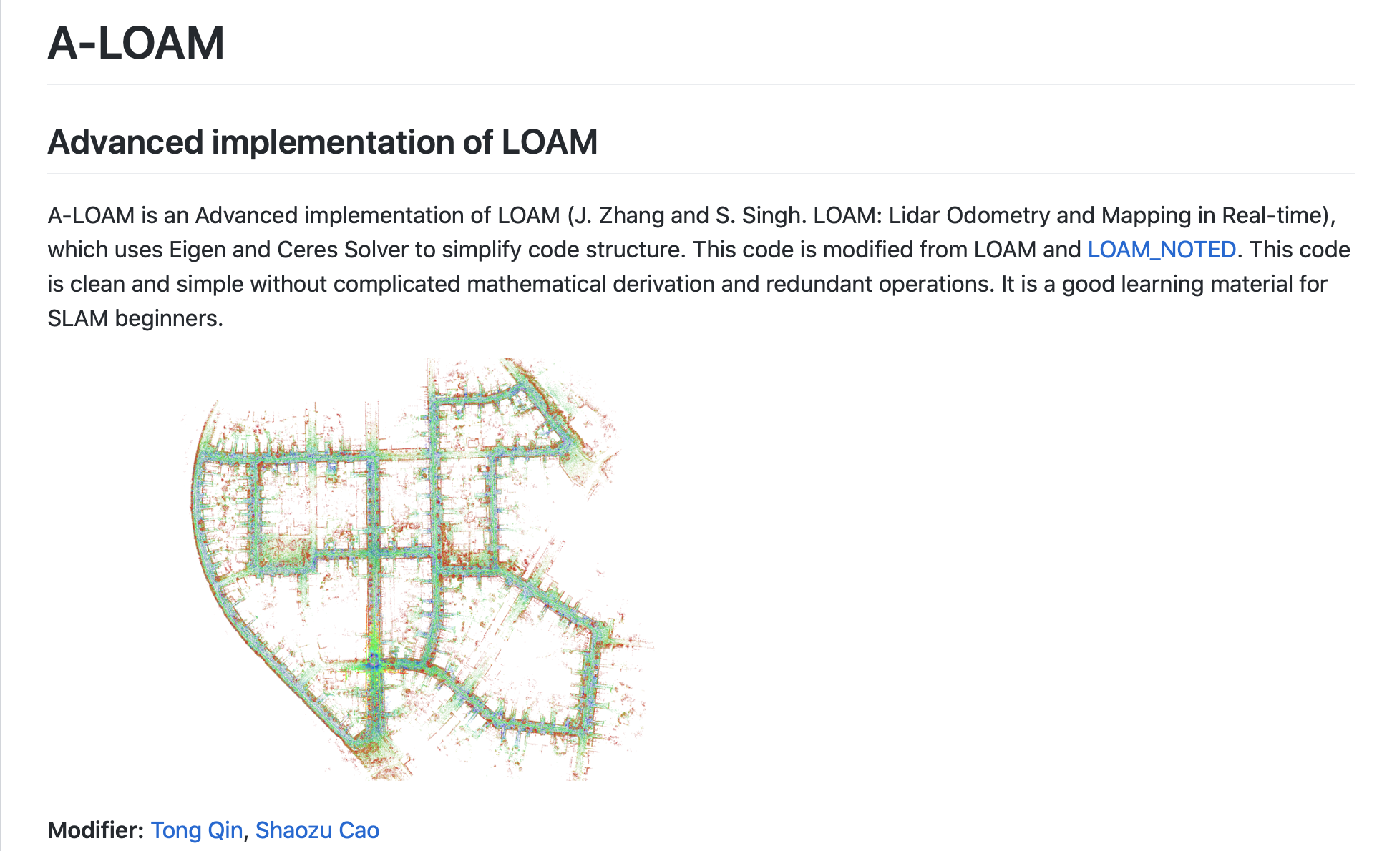
Background on the Basic Algorithm
We selected A-LOAM as our starting point
It is simple to implement
Does not involve the complex mathematical processes involved in loop closures
Additionally, it is fast, and the only necessary input is a single Lidar point cloud, which was taken from the car_RGB dataset
Highlights the strengths and failure points of basic lidar SLAM
Lacks many features of a more complex system like LeGO-LOAM
Ground point extraction or segmentation
Option to integrate IMU
Loop closures

Slide 4
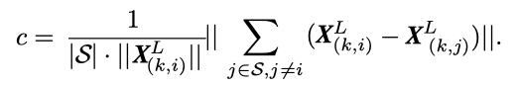
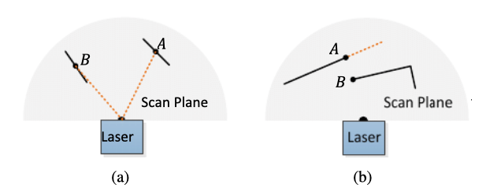
Lidar Odometry
The equation for local smoothness [1]
Feature point extraction
C defined to evaluate smoothness of the local surface
Results sorted by smoothness, feature points selected by excluding:
Points which do not pass the threshold c values for edge or planar points
Points surrounded by other feature points or exceeding the set limit number of points for a region
Planar points where the plane runs near parallel to the laser
Edge points on the boundary of occluded regions
Image from the paper showing a) a point B which is on a plane unsuitable for precise measurements and b) a point A on the edge of an occluded region which may be observable from a different scan [1]

Slide 5
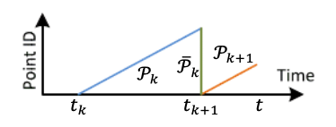
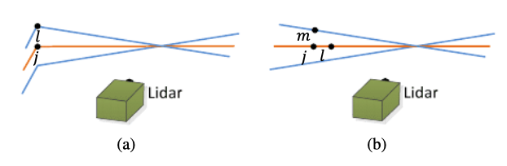
Lidar Odometry
Finding feature point correspondence
Algorithm estimates the motion of the vehicle within a given sweep, reprojects the point cloud at the end of the sweep
Matches points from the new sets of edge and planar points to past reprojection
Distance between a feature point and its correspondence is calculated
A graph depicting the collection of a point cloud Pk, and its reprojection in green during the following sweep, shown in orange [1]
An illustration of identifying edge lines and planar patches as correspondence where j is the nearest point to the feature point in the current scan (shown as the orange line). In a) the case of an edge point, another point l is found as the closest neighbor on one of the two consecutive scans (shown as the blue lines). In b) for a planar point, the same process is done to find j, and l is found as the closest point in the same scan, m as the closest in a following scan [1]

Slide 6
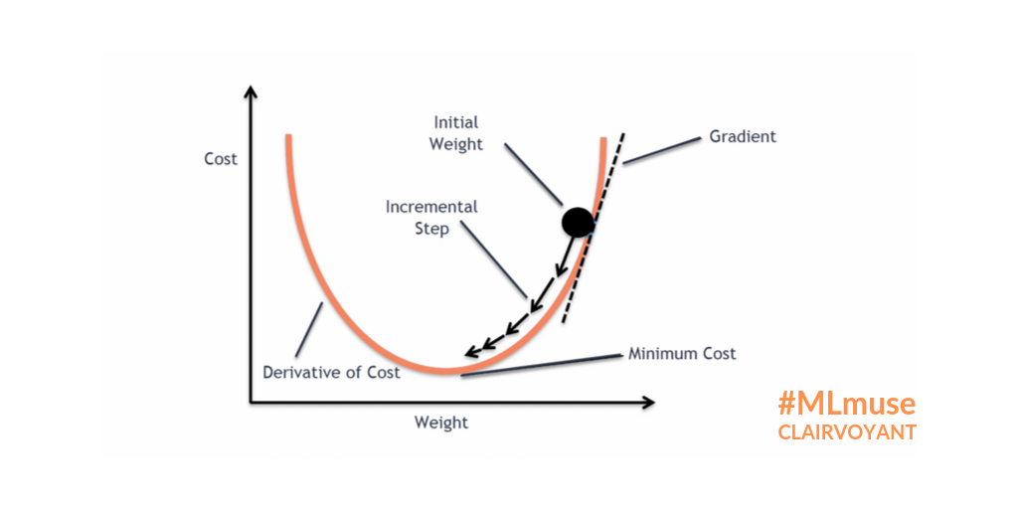
Lidar Odometry
Motion estimation
Assumes constant angular and linear velocities during a sweep
Corrects for motion within a sweep using linear interpolation
Employs the Levenberg-Marquardt algorithm to solve the lidar motion problem
Frequently used to solve non-linear least squares problems
Iteratively reduces the sum of the squares of the errors between the function and measured data by updating parameter values*
Combines gradient descent and the Gauss-Newton Method [3]
Runs until convergence is found or it hits the maximum number of iterations
*taken from The Levenberg-Marquardt algorithm for nonlinear least squares curve-fitting problems
Example image of gradient descent from https://blog.clairvoyantsoft.com/the-ascent-of-gradient-descent-23356390836f
The final equation given by the Levenberg-Marquardt method [1]

Slide 7
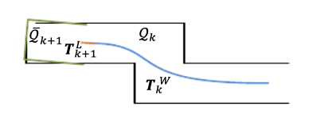
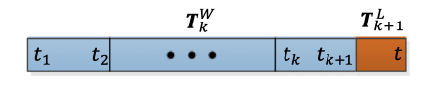
Lidar Mapping
Running at 1Hz, the mapping algorithm runs once per sweep
Takes undistorted point cloud and estimated motion during the sweep
Matches new cloud with previously generated world coordinates
Feature points extracted similarly to before
10 times the number of feature points from odometry, which ran at 10Hz
Map stored in 10m cube sections
Orientation matching also similar to odometry, again using the Levenberg-Marquardt algorithm
A visualization of the matching algorithm in mapping [1]
Illustration of the pose estimation for the mapping [1]

Slide 8
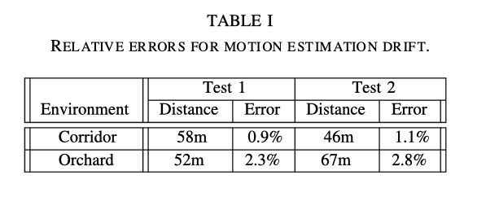
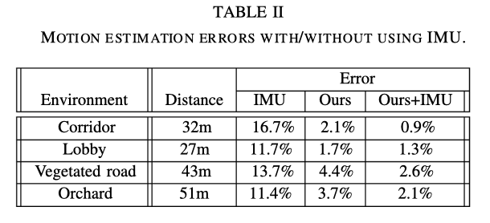
Interesting Points from the Paper
Data taken in areas with significant and clear features yield better results
Reduces drift
Our data have good conditions
Vegetation seems to be difficult for the algorithm
Point matching is less clear without planar features or consistent edges
The authors later used a Kalman filter to integrate the IMU, and found reduced motion estimation error
Objects at greater distances tend to be seen as smoother
These objects have a lower point density
Also less important in the mapping
However this poses an issue for objects as they get closer or further away, as their features points begin to change
Tables showing the results from the paper in different environments on the top as well as with IMU integration on the bottom [1]

Slide 9
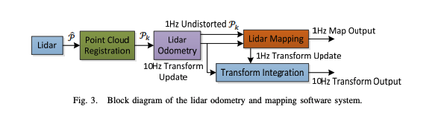
Codebase Structure
Chose A-LOAM implementation due to its ease of understanding
“This code is clean and simple without any complicated mathematical derivation or redundant operations.” - Generation Robots
scanRegistration.cpp
Point of interpretation for the raw PointCloud data from LiDAR
Feature extraction (corners & flat surfaces) on current scene
laserOdometry.cpp - 10Hz
Feature comparisons on consecutive frames
laserMapping.cpp - 1 Hz
Interprets the movement of the LiDAR using odometry, publishes & updates a world map

Slide 10

A-LOAM Demo
Notes:
Ease of analyzing/running the code

Slide 11
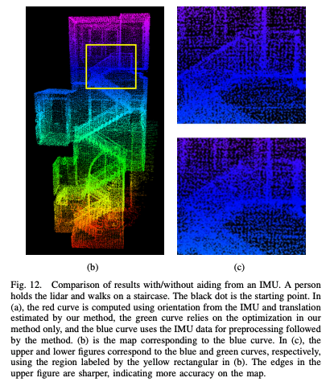
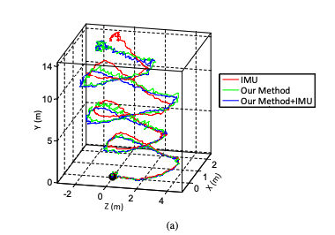
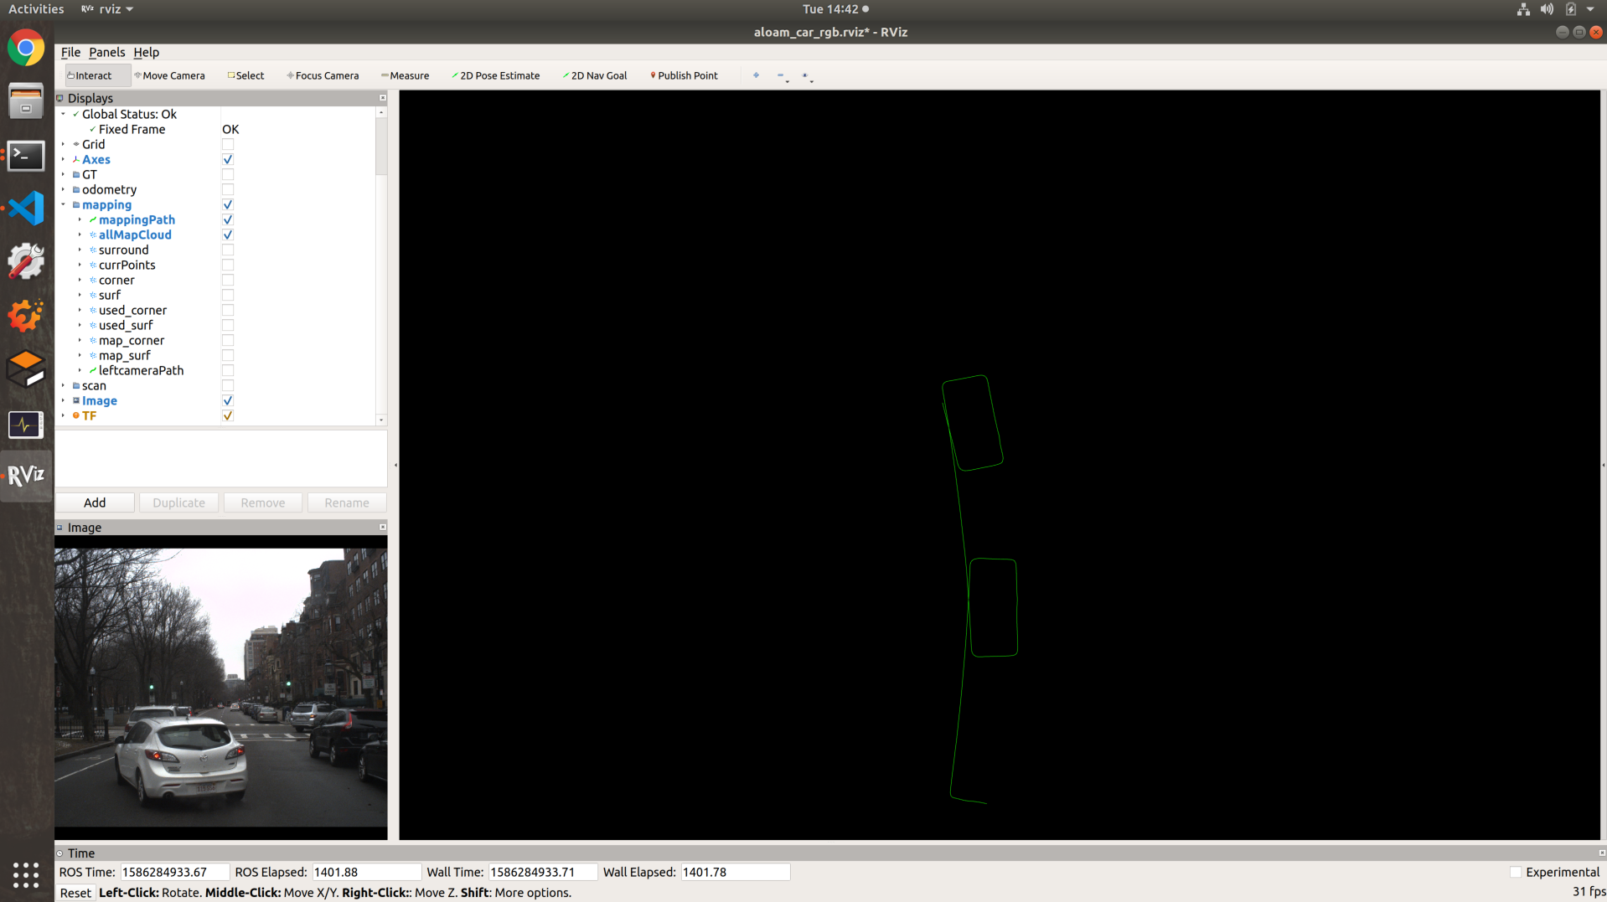
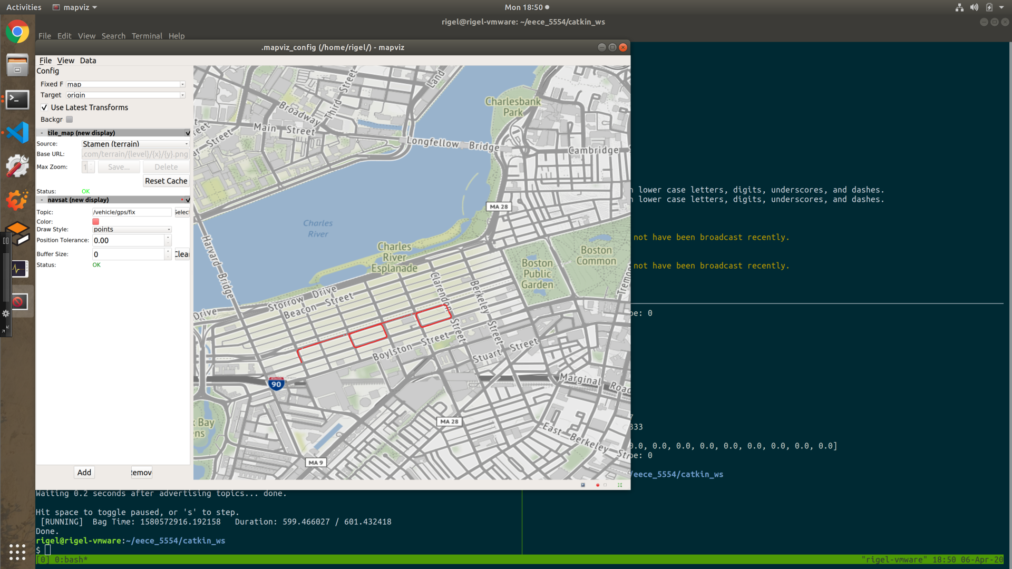
A-LOAM Failure Points
Over time, position drifts slightly
A-LOAM does not:
Employ loop closures
Accept input from any other sensors
Easily implementable, but not robust
GPS
A-LOAM; 1 Lidar
Image Source: https://www.roboticsproceedings.org/rss10/p07.pdf

Slide 12
Loop Closures
The A-LOAM algorithm lacks any implementation of loop closures
This results in drift throughout the processing of the data, which could be reduced as there are two loops with significant overlap in the dataset provided
We would like to attempt to implement a loop closure process within the existing A-LOAM framework, in order to determine the advantage this gives in reducing drift
The data in car_RGB are ideally suited to loop closure given the high degree of overlap in the loops as the car retraces its path along Commonwealth
Can be implemented using visual data, or using the PointCloud data itself, as is the case in LeGO-LOAM

Slide 13
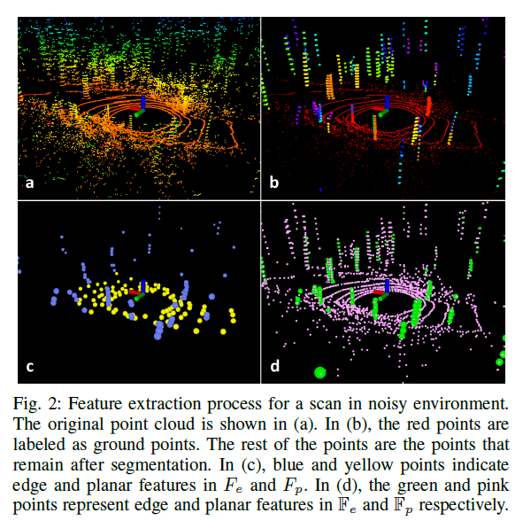
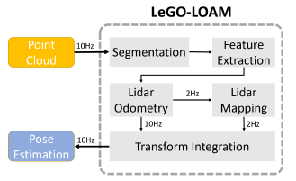
LeGO-LOAM
a lightweight and ground-optimized lidar odometry and mapping method
System overview of LeGO-LOAM^{[2]}
Results of LeGO-LOAM blocks^{[2]}
[2]: LeGO-LOAM: Lightweight and Ground-Optimized Lidar Odometry and Mapping on Variable Terrain

Slide 14
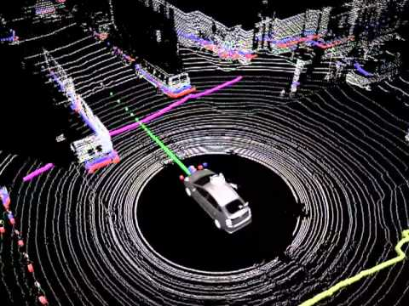
Ground Point Extraction
Project point cloud to range image
A column-wise evaluation of the range image, which can be viewed as ground plane estimation, is conducted for ground point extraction before segmentation.
(The paper does not assume the ground is ﬂat. )
Points regarded as ground are given “ground” tag and not used for segmentation, and only remaining points are divided into different clusters.
Ground point extraction schematic
Image Source: https://www.google.com/url?sa=i&url=https%3A%2F%2Fwww.youtube.com%2Fwatch%3Fv%3DnXlqv_k4P8Q&psig=AOvVaw1E6CZgUCo04f7wgzZIfYV2&ust=1586466718020000&source=images&cd=vfe&ved=0CAIQjRxqFwoTCMC8w6Hf2egCFQAAAAAdAAAAABAO

Slide 15
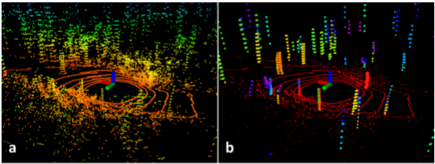
Segmentation
Group points in range image into many clusters (invoked from other paper)
Omit the clusters that have fewer than 30 points
Only the points that may represent large objects, e.g., tree trunks, and ground points are preserved for further processing
Only preserved points are saved in the range image
Results after segmentation step^{[2]}
[2]: LeGO-LOAM: Lightweight and Ground-Optimized Lidar Odometry and Mapping on Variable Terrain

Slide 16
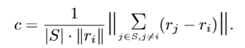
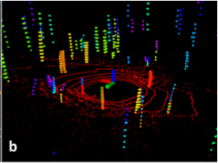
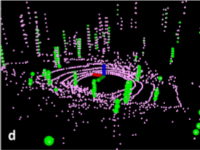
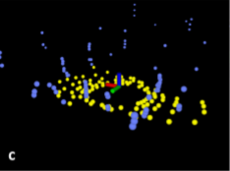
Feature Extraction
To evenly extract features from all directions, we divide the range image horizontally into several equal sub-images
We call the points with c larger than c_{th} edge features, and the points with c smaller than c_{th} planar features.
Select strongest edge features and planar features, features with maximum or minimum c values.
Reflection:
When r_{i} is at the denominator, further features trend to be judged as planar features, as you can see for further tree trunks. I think it may not be reasonable.
Can we make the threshold c_{th} a floating value to make the algorithm adaptive to varying environment?
Is it possible to traverse the range map by a window, i.e. extract features on a higher level? Convolution?
As most edge features distribute near to the lidar, what if they are moving objects? I think it would be better if edge features are evenly distributed along the distance.
Results of feature extraction and selection, in(d), edge features are green and planar features are pink. In (e) strongest edge features are blue and strongest planar features are yellow^{[2]}
[2]: LeGO-LOAM: Lightweight and Ground-Optimized Lidar Odometry and Mapping on Variable Terrain

Slide 17
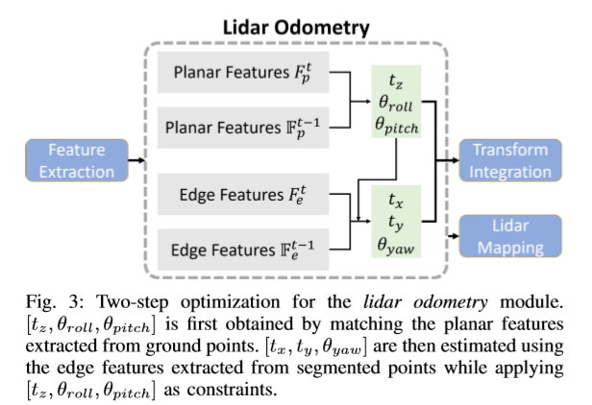
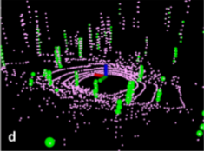
Lidar Odometry
The lidar odometry module estimates the sensor motion between two consecutive scans
Feature matching
Label matching
Two-step Levenberg-Marquardt Optimization
Reflection:
As we can see further trunks are regarded as planar features, while nearer ones are viewed as edge features. In this case, it may not be possible to match further trucks when they get closer, especially when we drive fast.
Lidar Odometry procedure^{[2]}
Feature selection^{[2]}
[2]: LeGO-LOAM: Lightweight and Ground-Optimized Lidar Odometry and Mapping on Variable Terrain

Slide 18
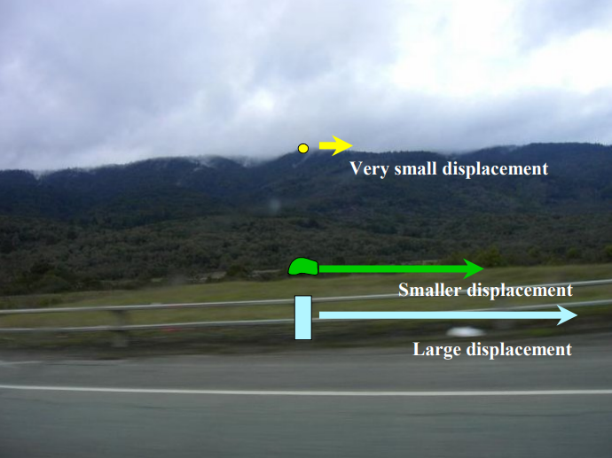
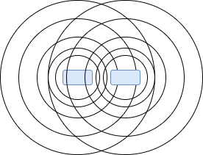
Reflection on Lidar Odometry (continued 1)
Due to stereo, objects nearer will move faster than those further from the perspective of lidar. In this case I think features on ground could be hard to match. As you can see they don’t have many intersections.
Most planar features are on the ground.
Stereo schematic
Source: http://www.cse.psu.edu/~rtc12/CSE486/lecture08.pdf
Feature Extraction results^{[2]}
[2]: LeGO-LOAM: Lightweight and Ground-Optimized Lidar Odometry and Mapping on Variable Terrain
Schematic of 2 consecutive scans on the ground

Slide 19
Lidar Mapping
Match current features with previous features, either of the approaches below.
Choose the feature sets whose sensor poses are within 100m of the current position of the sensor. The chosen feature sets are then transformed and fused into a single surrounding map generated at the last instant
Integrate pose-graph SLAM into LeGO-LOAM. The author thinks the pose estimation drift of the lidar mapping module is very low, so we can assume that there is no drift over a short period of time. So the matching is only between current feature sets and a group of past feature sets.

Slide 20
Difference between LeGO-LOAM and LOAM
LeGO-LOAM has a segmentation procedure, which filters out clusters having less than 30 points. It improves processing efﬁciency and feature extraction accuracy.
LeGO-LOAM has a unique type of feature, ground detection. Ground points are exclude from edge feature extraction and are only for planar feature extraction.
Map storage: LOAM saves a single point cloud map, while LeGO-LOAM saves each individual feature set.

Slide 21
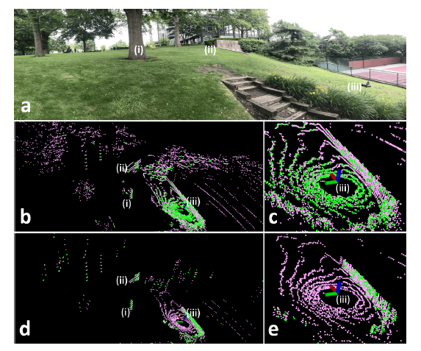
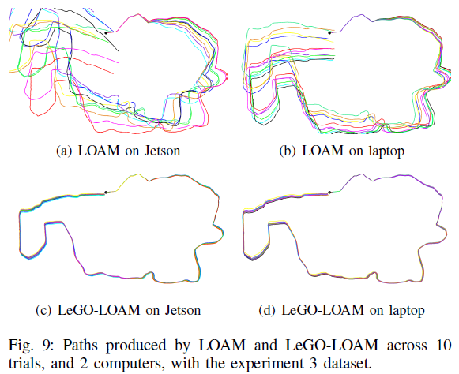
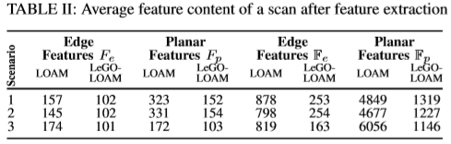
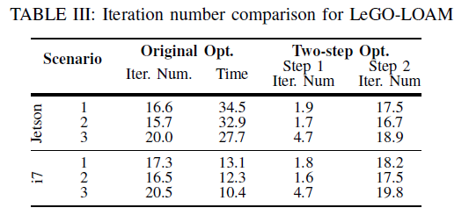
Results in the LeGO-LOAM paper
Number of feature points is reduced considerably.
Most edge feature points are not on the ground
Still many planar feature points on the ground
Edge and planar features are colored green and pink, respectively. The features obtained from LOAM are shown in (b) and (c). The features obtained from LeGO-LOAM are shown in (d) and (e).
There are grass and trees in the way, which will result in unreliable feature extraction in LOAM. As a result, LOAM’s pose estimation diverges.^{[2]}

Slide 22
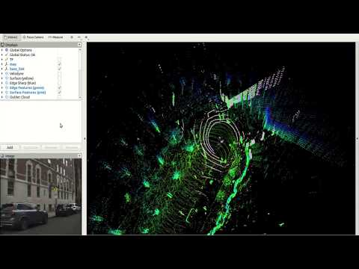
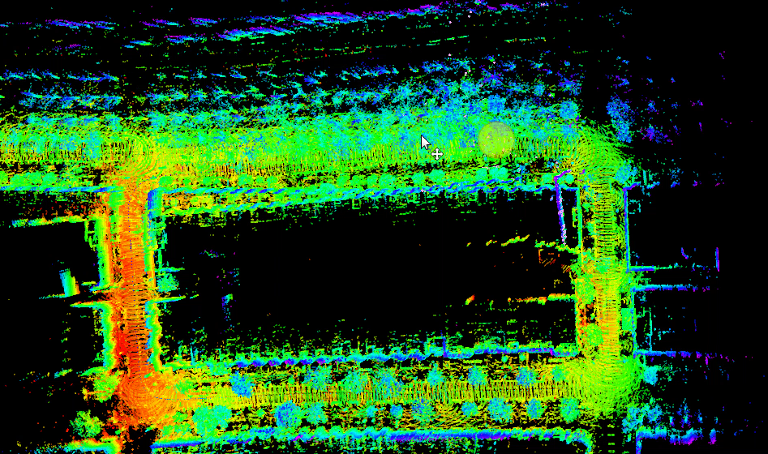
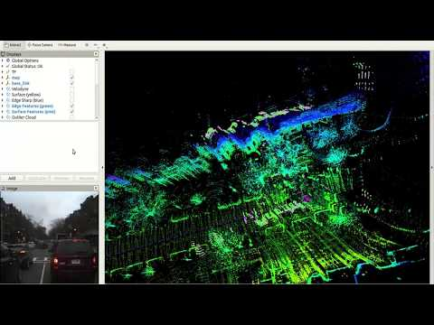
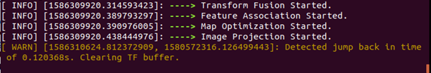
Results of running LeGO-LOAM
Using IMU raw data
drifting
Diving into the ground because time jump back

Slide 23
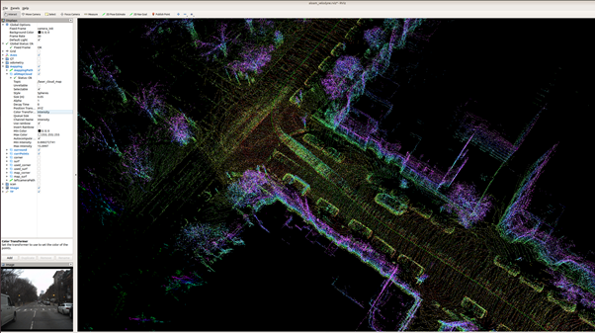
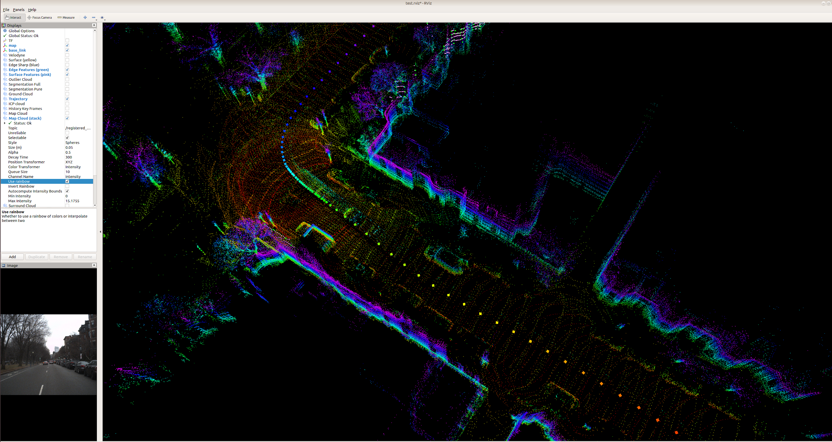
Results of running A-LOAM and LeGO-LOAM(Continued 1)
LeGO-LOAM generate a map with less features, and it looks clearer. But it is also omitting a lot of features on cars. I think we can figure out what the typical difference is between cars’ data (shouldn’t omit) and leaves’ data (already largely omitted) and do some modifications.

Slide 24
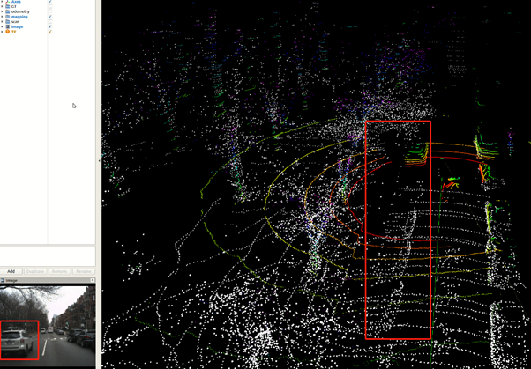
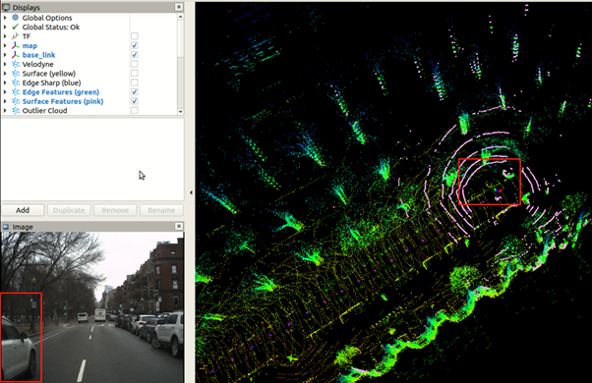
Results of running A-LOAM and LeGO-LOAM(Continued 2)
Neither A-LOAM nor LeGO-LOAM is able to filter out moving objects

Slide 25
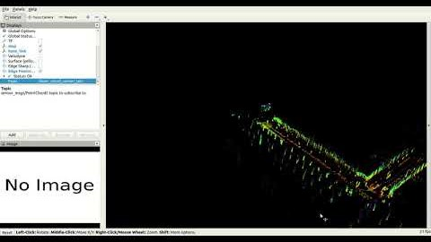
A Possible Way to Remove Moving Objects
As LeGO-LOAM does feature matching to estimate Lidar Odometry and Integrate it into Transform between scans later, and the map generated is not bad. So we imply that those matched features is likely to be on stationary objects. Because if those features are on moving object, the Lidar Odometry will have considerable error, so as the map.
We extracted those matched corner features (named edge features in the paper) and only used them to generate map. The modification to the code is basically publishing matched corner feature points instead of all feature points to construct the map.
As is shown in the video, matched feature points are on both moving and stationary objects, so this approach almost doesn’t help. Transform is affected as well.

Slide 26
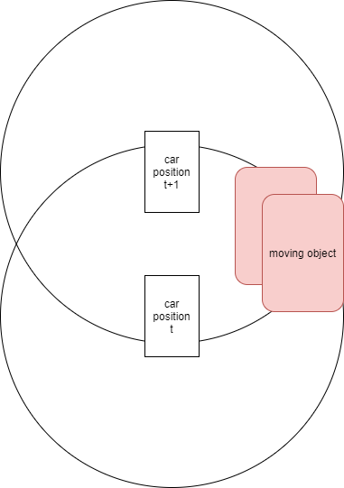
Another Possible Way to Remove Moving Objects
According to our observation, a large number of ghosting happened near to our car. In addition, those moving objects moved in the same direction as our car did in most cases.
This kind of moving objects are likely to be seen in both of 2 consecutive scans. So we set a threshold range, which is shown as the 2 circles. We transformed all corner features and planar features scanned at time t+1 to frame of time t respectively. Then we examined the squared distance between transformed feature points of t+1 and feature points of t. If the result is less than a threshold, the feature point will be evaluated as being on moving objects, and it will be popped out from point set used for map construction.

Slide 27
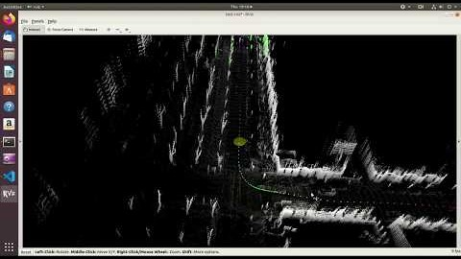
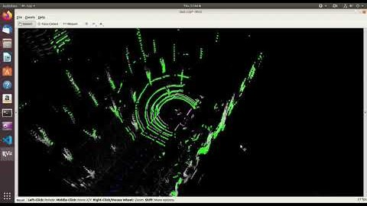
Filtering Out Moving Features Within a certain Range
Corner feature filtering results
Planar feature filtering results
Filtering out ghosting corner features with in 6 meters. Green points are remaining corner features, while purple points are all corner features extracted, before filtering. Only green points will be used for mapping later. As you can see from 1:10, an approaching car is filtered out, so it won't show up on the map. But as you can see from 0:25 and 1:30, corner features with a distance to our car larger than 6 meters can not be filtered. The range needs optimization, if it is too large, the quality of map will decrease, while if it is too small, the filter will not make much sense.
Filtering out ghosting planar features with in 6 meters. Green points are remaining planar features, while purple points are all planar features extracted, before filtering. Only green points will be used for mapping later. As you can see from 1:07, an approaching car is filtered out, so it won't show up on the map. But as you can see from 0:22 and 1:30, planar features with a distance to our car larger than 6 meters can not be filtered. The range needs optimization, if it is too large, the quality of map will decrease, while if it is too small, the filter will not make much sense. The map construction occluded outlier feature points, as I don't know what they are after inspecting the source code.

Slide 28
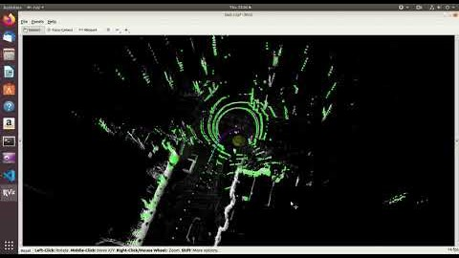
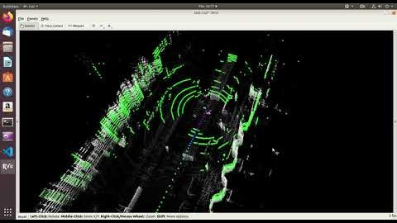
Filtering Out Moving Features Within a certain Range
Filtering out both corner features and planar features
Filtering out both ghosting planar features and ghosting corner features with in 6 meters. Green points are remaining features, while purple points are all features extracted, before filtering. Only green points will be used for mapping later. As you can see from 1:22, an approaching car is filtered out, so it won't show up on the map. But as you can see from 0:38 and 1:46, features with a distance to our car larger than 6 meters can not be filtered. The range needs optimization, if it is too large, the quality of map will decrease, while if it is too small, the filter will not make much sense. The map construction occluded outlier feature points, which is a type of points independent from corner feature points and planar feature points, as I don't know what they are after inspecting the source code.
As you can see that most features within a 6 meter range to the car is filtered out. But the truck in front of us was consistently mapped, as features on the truck is out of the range so they can not be filtered out. The range needs optimization, if it is too large, the quality of map will decrease, while if it is too small, the filter will not make much sense. The map construction occluded outlier feature points, which is a type of points independent from corner feature points and planar feature points, as I don't know what they are after inspecting the source code.

Slide 29
Reflection
The value of the range should depends on the situation our car is in. For example, if the road is narrow, the range value should be lower, so buildings on the side can still be mapped clearly, vise versa. But if the range is too large, this approach could be computationally expensive and may not able to run in real time.
A further exploration of this approach could be control system design to make it a dynamic value to get optimal filtering.
To reduce computation expense, a fast-matching approach should be designed. I think it would be likely to be based on data structure of Pointcloud and its indexing.
Anyway, I think it is rough and hard to match feature points based on point-wise matching to filter out moving feature points. I think moving objects(features) detection should be based on some kind of high level abstraction of data, probably a patch in Pointcloud?

Slide 30
References
[1] LOAM: Lidar Odometry and Mapping in Real-time by Ji Zhang and Sanjiv Singh
[2] LeGO-LOAM: Lightweight and Ground-Optimized Lidar Odometry and Mapping on Variable Terrain
[3] The Levenberg-Marquardt algorithm for nonlinear least squares curve-fitting problems
Gitlab repository: https://gitlab.com/Zuchen_NEU/eece5554_roboticssensing

